Slide 1
MULTI-ASPECT SENTIMENTAL_ANALYSIS
Multi-aspect Sentiment Analysis by using online hotel reviews, specifically mining comments from non-local, non-regional domestic tourists
Notes:
<number>

Slide 2

KEY CONTENTS
Extraction of Data
Data Pre-processing
What to do next

Slide 3
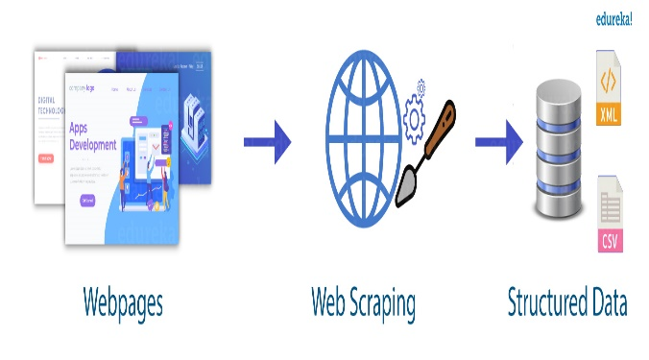
EXTRACTION OF DATA
Web Scrapping
Technique employed to extract large amounts of data from websites whereby the data is extracted and saved to a local file in your computer or to a database in table format.

Slide 4


TOOLS | Scrapping
WEB SCRAPER | CHROME EXTENSION
Extension through which you can create a sitemap, how a web site should be traversed and what should be extracted. Using these sitemaps the Web Scraper will navigate the site accordingly and extract all data. Scraped data later can be exported as CSV.
SCRAPY | PYTHON LIBRARY
Scrapy is a Python framework for web scraping that provides a complete package for developers without worrying about maintaining code.

Slide 5
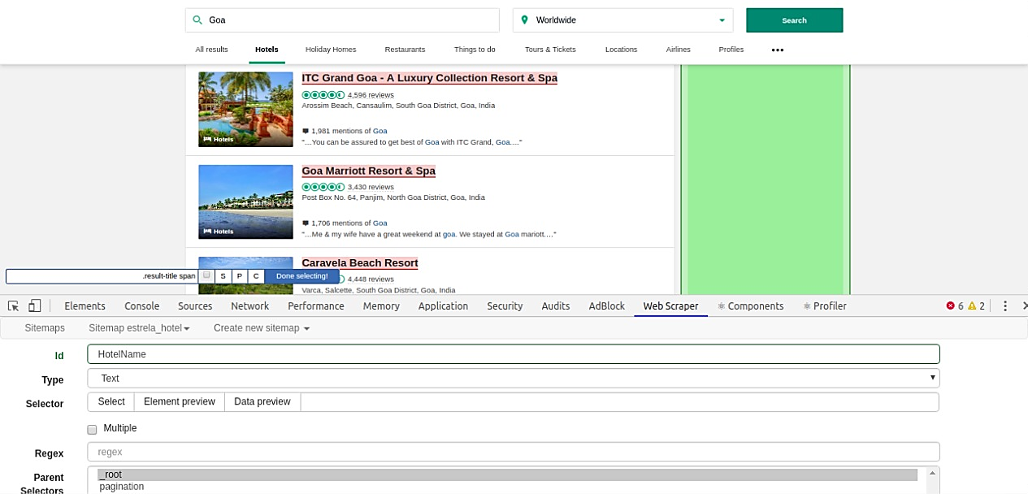
WEB SCRAPPER | Scrapping

Slide 6
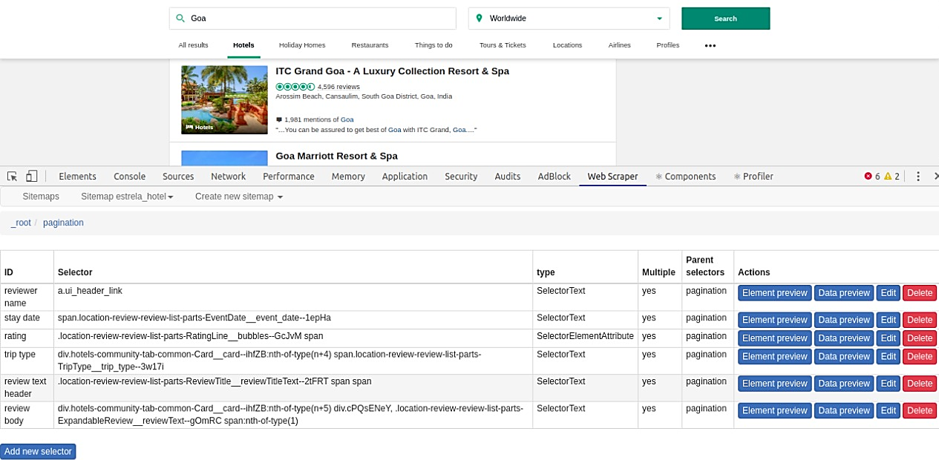
WEB SCRAPPER | Scrapping

Slide 7
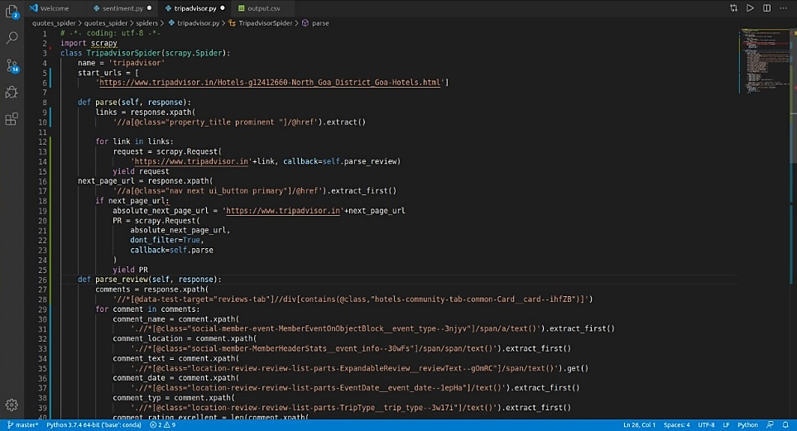
SCRAPY | Scrapping

Slide 8
DATA PREPROCESSING
BASIC FEATURE EXTRACTION
Number of Words
Number of Characters
Average word length
Number of Stopwords
Number of Special Characters
Number of Numerics
Number of Uppercase Words
DATA PREPROCESSING
TEXT PREPROCESSING
Lower Casing
Punctuation Removal
Stopwords Removal
Frequent Word Removal
Rare Words Removal
Spelling Correction
Tokenization
Lemmatization

Slide 9
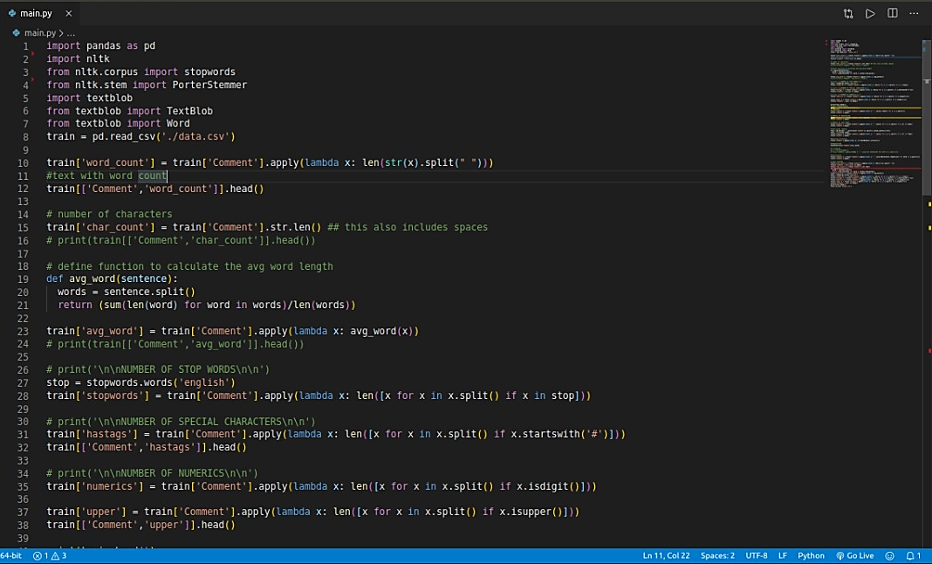
Basic Feature Extraction

Slide 10
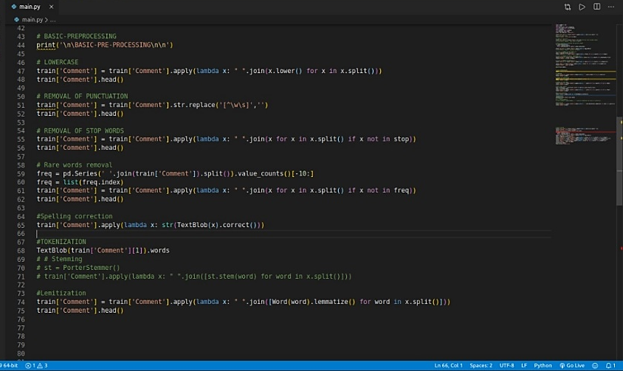
Text Pre-processing

Slide 11
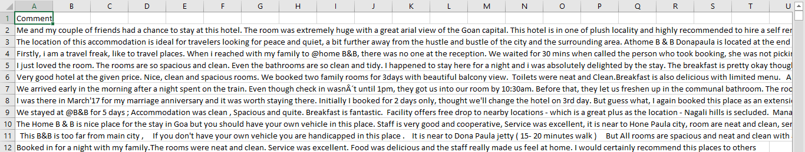
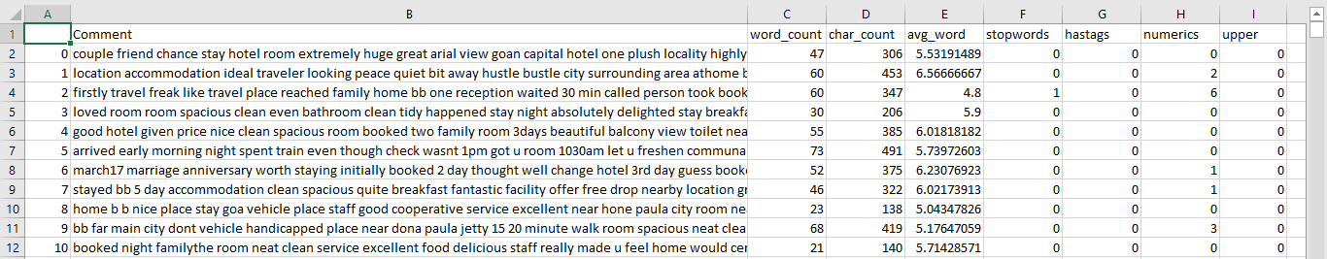
Text Pre-processing
BEFORE
AFTER

Slide 12
WHAT TO DO NEXT …?
Advance Text Processing
N-grams
Term Frequency
Inverse Document Frequency
Term-Frequency Inverse Document
Frequency (TF-IDF)
Bag of Words
Sentiment Analysis Modal
Feature Extraction
Latent Dirichlet allocation Algorithm

Slide 13
THANK YOU
GROUP D
Notes:
In Slide Show mode, click the arrow to enter the PowerPoint Getting Started Center.
<number>

